Slide 1
HKN ECE 310 Quiz 6 Review Session
Corey Snyder

Slide 2
Topics
Digital Rate Conversion: Upsampling, Downsampling
D/A: Review of Ideal and ZOH, Upsampled D/A
FFT: Decimation in Frequency and Time
Circular Convolution, Linear Convolution using FFT

Slide 3
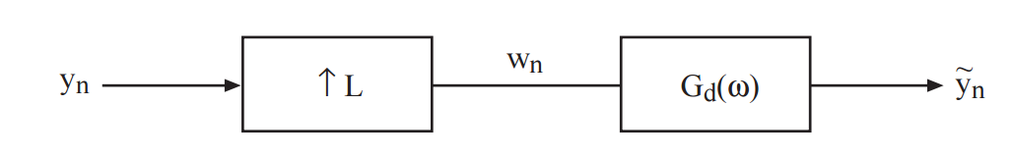
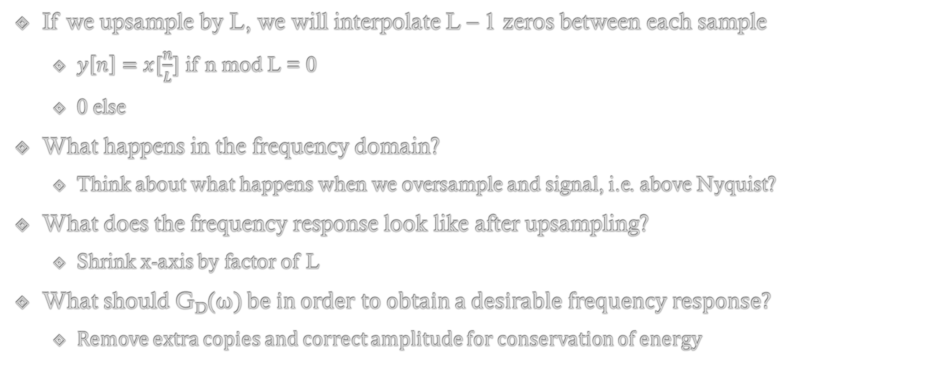
Upsampling
If we upsample by L, we will interpolate L – 1 zeros between each sample
$y\left[n\right]=x[\frac{n}{L}]$ if n mod L = 0
0 else
What happens in the frequency domain?
Think about what happens when we oversample and signal, i.e. above Nyquist?
What does the frequency response look like after upsampling?
Shrink x-axis by factor of L
What should G_{D}(ω) be in order to obtain a desirable frequency response?
Remove extra copies and correct amplitude for conservation of energy

Slide 4
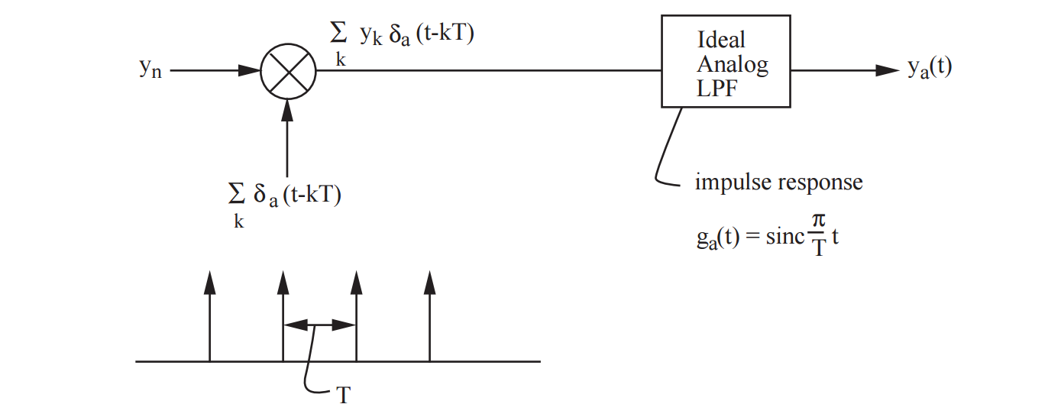
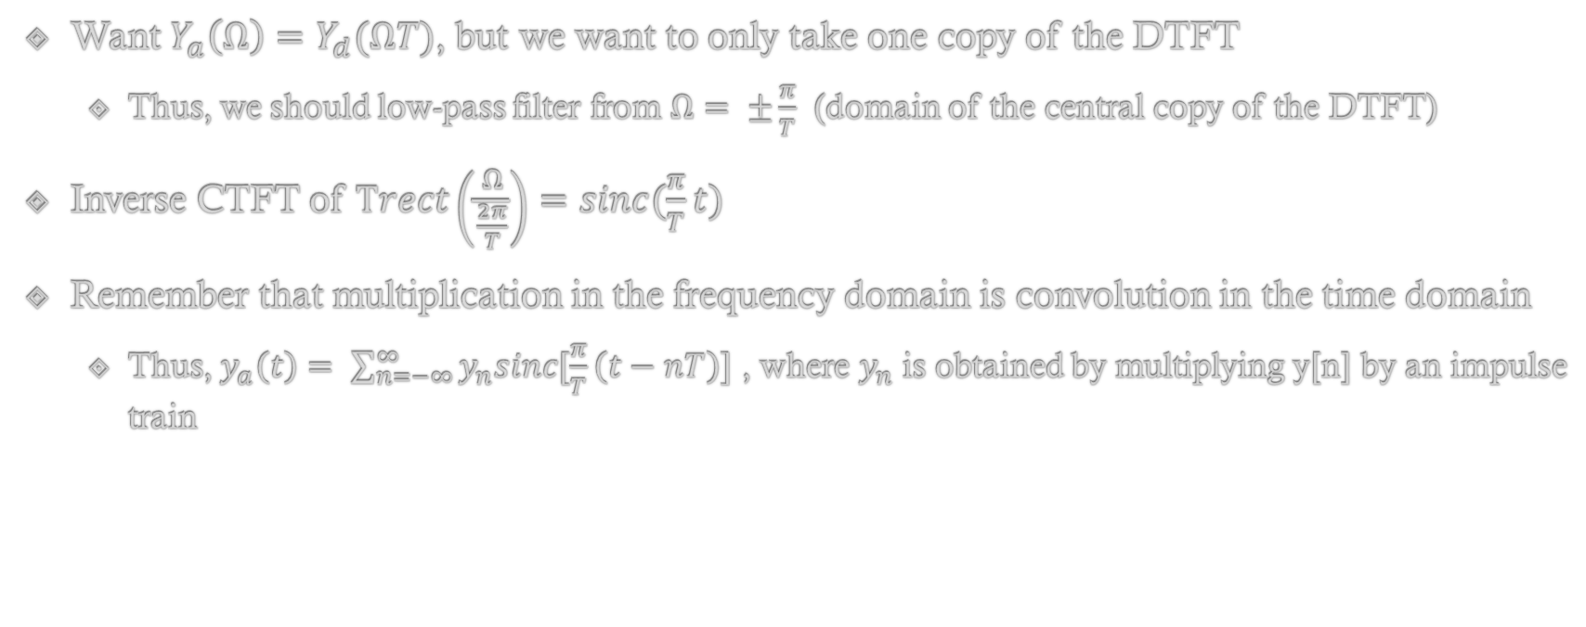
Review: Ideal D/A
Want $Y_{a}\left(Ω\right)=Y_{d}(ΩT)$, but we want to only take one copy of the DTFT
Thus, we should low-pass filter from $Ω= ±\frac{π}{T}$ (domain of the central copy of the DTFT)
Inverse CTFT of $Trect\left(\frac{Ω}{\frac{2π}{T}}\right)=sinc(\frac{π}{T}t)$
Remember that multiplication in the frequency domain is convolution in the time domain
Thus, $y_{a}\left(t\right)= \sum_{n=−∞}^{∞}{y_{n}sinc[\frac{π}{T}\left(t−nT\right)]}$ , where $y_{n}$ is obtained by multiplying y[n] by an impulse train

Slide 5
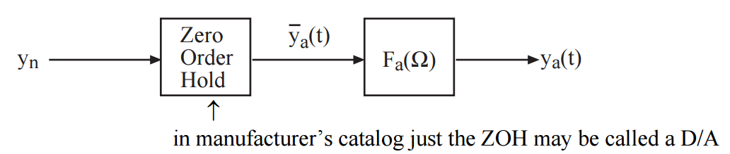
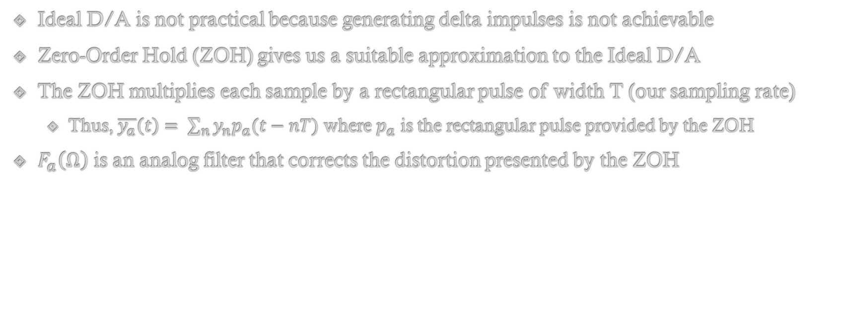
Review: Zero-Order Hold
Ideal D/A is not practical because generating delta impulses is not achievable
Zero-Order Hold (ZOH) gives us a suitable approximation to the Ideal D/A
The ZOH multiplies each sample by a rectangular pulse of width T (our sampling rate)
Thus, $\overline{y_{a}}\left(t\right)= \sum_{n}{y_{n}p_{a}(t−nT)}$ where $p_{a}$ is the rectangular pulse provided by the ZOH
$F_{a}\left(Ω\right)$ is an analog filter that corrects the distortion presented by the ZOH

Slide 6
Upsampled D/A
Upsampling prior to D/A conversion can make recovery simpler
i.e. Compensator F_{a}(Ω) can be simpler to implement
Upsampling effectively increases our sampling frequency, thus our ZOH pulse can be narrower and give us a better staircase approximation
This ‘smoother staircase’ will be easier to rectify with the compensator
i.e. the transition bandwidth will be larger
In the frequency domain, we see the frequency axis compress by L; however, the analog frequencies upon recovery do not change!

Slide 7
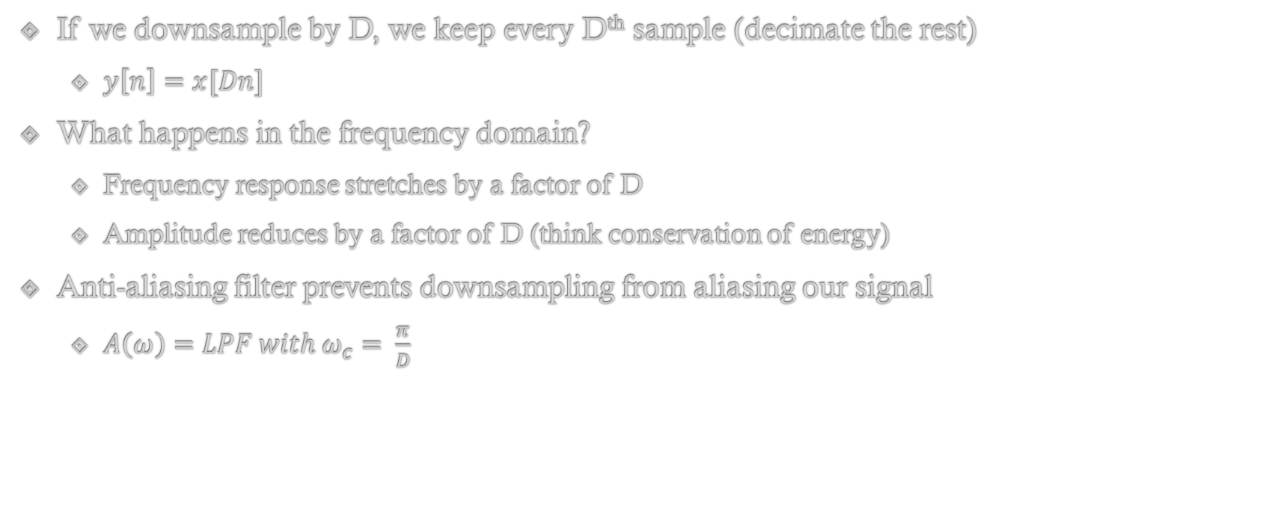
Downsampling
If we downsample by D, we keep every Dth sample (decimate the rest)
$y\left[n\right]=x[Dn]$
What happens in the frequency domain?
Frequency response stretches by a factor of D
Amplitude reduces by a factor of D (think conservation of energy)
Anti-aliasing filter prevents downsampling from aliasing our signal
$A\left(ω\right)=LPF with ω_{c}= \frac{π}{D}$

Slide 8
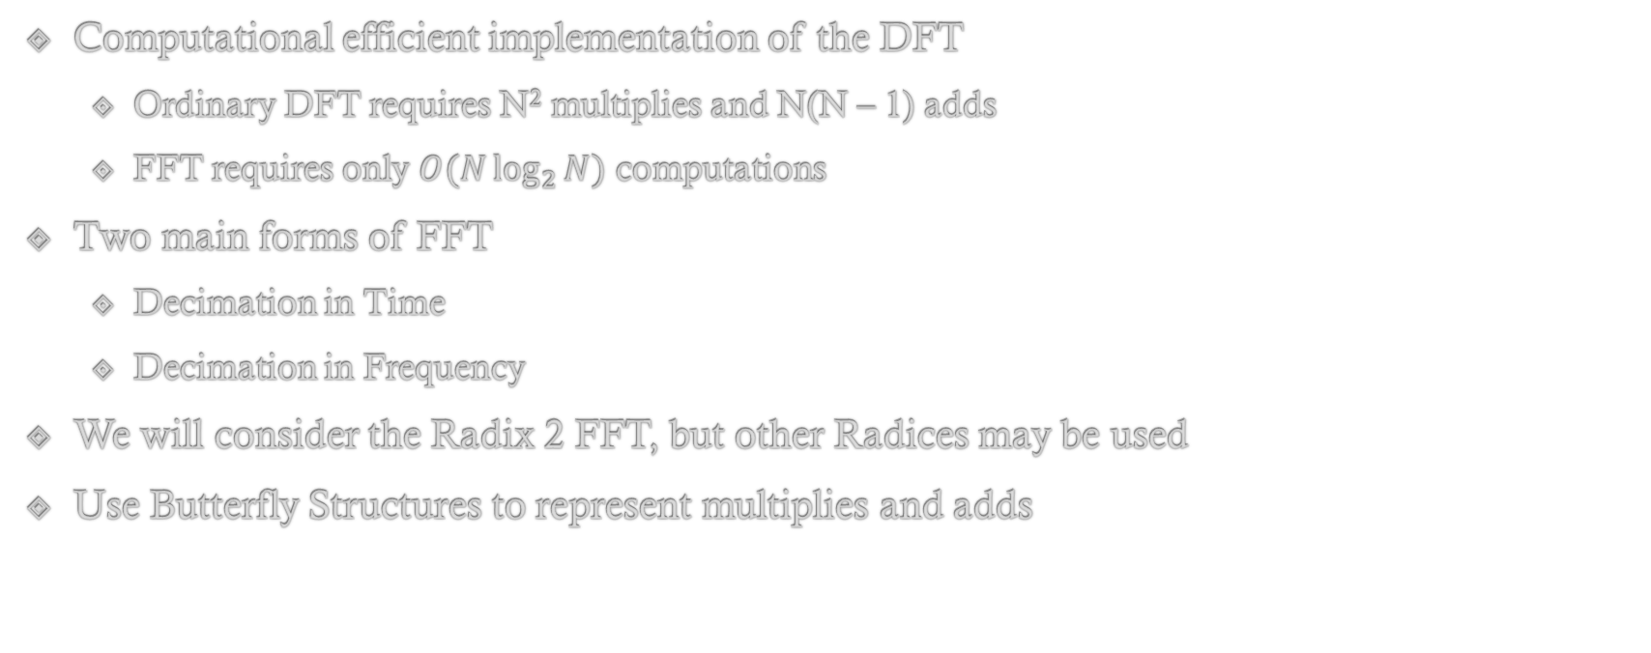
Fast Fourier Transform
Computational efficient implementation of the DFT
Ordinary DFT requires N² multiplies and N(N – 1) adds
FFT requires only $O(N\log_{2}{N})$ computations
Two main forms of FFT
Decimation in Time
Decimation in Frequency
We will consider the Radix 2 FFT, but other Radices may be used
Use Butterfly Structures to represent multiplies and adds

Slide 9
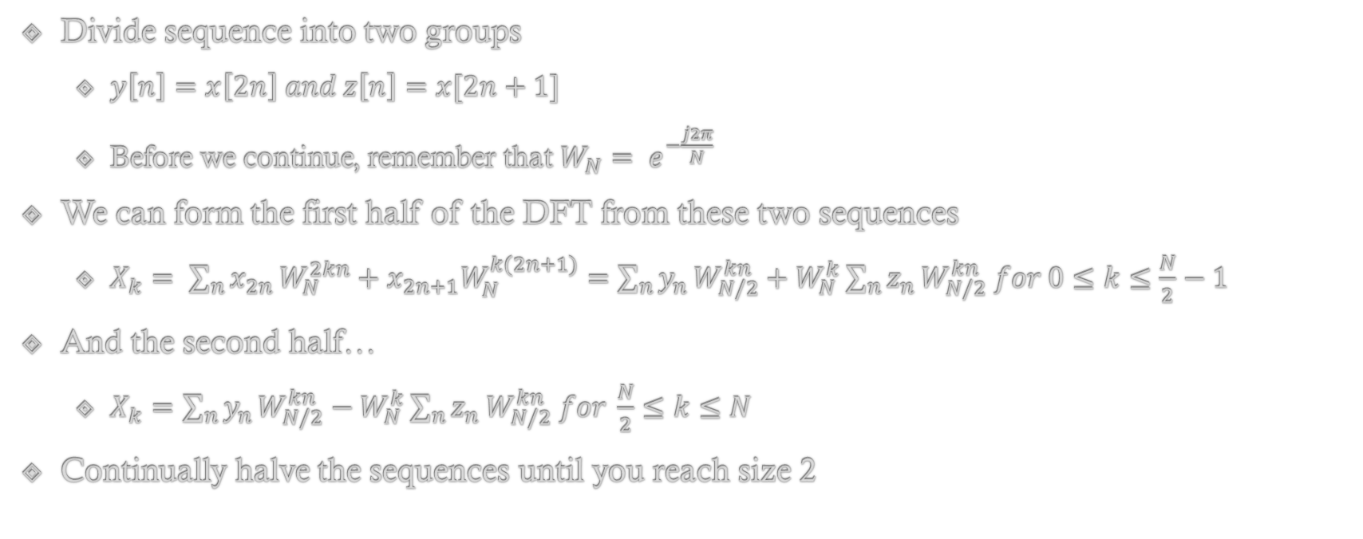
Decimation in Time
Divide sequence into two groups
$y\left[n\right]=x\left[2n\right] and z\left[n\right]=x[2n+1]$
Before we continue, remember that $W_{N}= e^{−\frac{j2π}{N}}$
We can form the first half of the DFT from these two sequences
$X_{k}= \sum_{n}{x_{2n}}W_{N}^{2kn}+x_{2n+1}W_{N}^{k(2n+1)}=\sum_{n}{y_{n}}W_{N/2}^{kn}+W_{N}^{k}\sum_{n}{z_{n}}W_{N/2}^{kn} for 0≤k≤\frac{N}{2}−1$
And the second half…
$X_{k}=\sum_{n}{y_{n}}W_{N/2}^{kn}−W_{N}^{k}\sum_{n}{z_{n}}W_{N/2}^{kn} for \frac{N}{2}≤k≤N$
Continually halve the sequences until you reach size 2

Slide 10
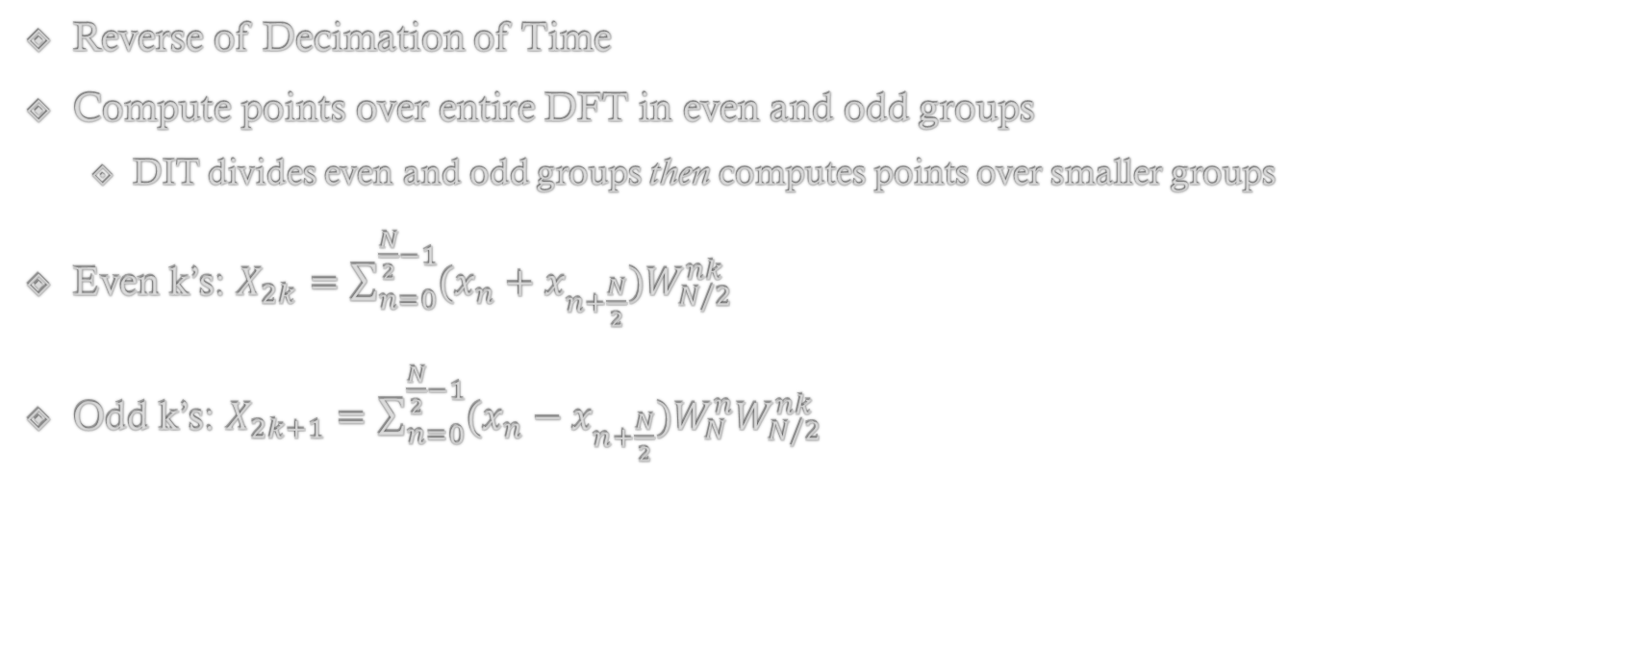
Decimation in Frequency
Reverse of Decimation of Time
Compute points over entire DFT in even and odd groups
DIT divides even and odd groups then computes points over smaller groups
Even k’s: $X_{2k}=\sum_{n=0}^{\frac{N}{2}−1}{(x_{n}+x_{n+\frac{N}{2}})W_{N/2}^{nk}}$
Odd k’s: $X_{2k+1}=\sum_{n=0}^{\frac{N}{2}−1}{(x_{n}−x_{n+\frac{N}{2}})W_{N}^{n}W_{N/2}^{nk}}$

Slide 11
Butterfly Structure Exercise
Draw the butterfly structure of a length 8 Decimation in Time FFT for x_{n}

Slide 12
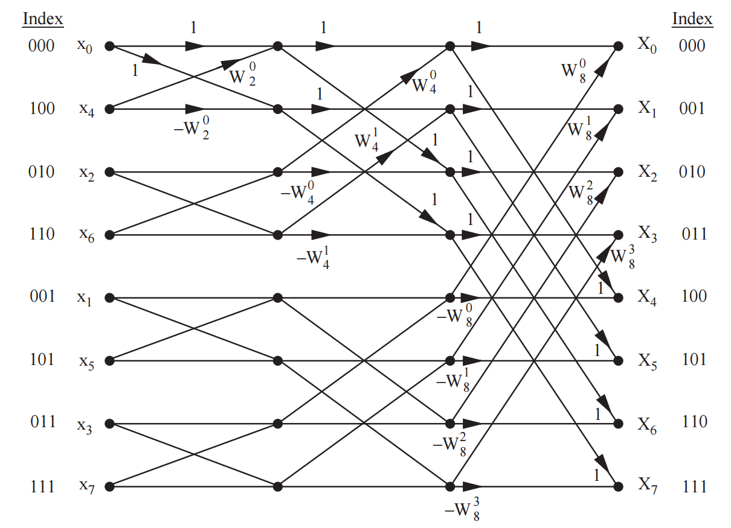
Butterfly Structure Exercise
Draw the butterfly structure of a length 8 Decimation in Time FFT for x_{n}

Slide 13
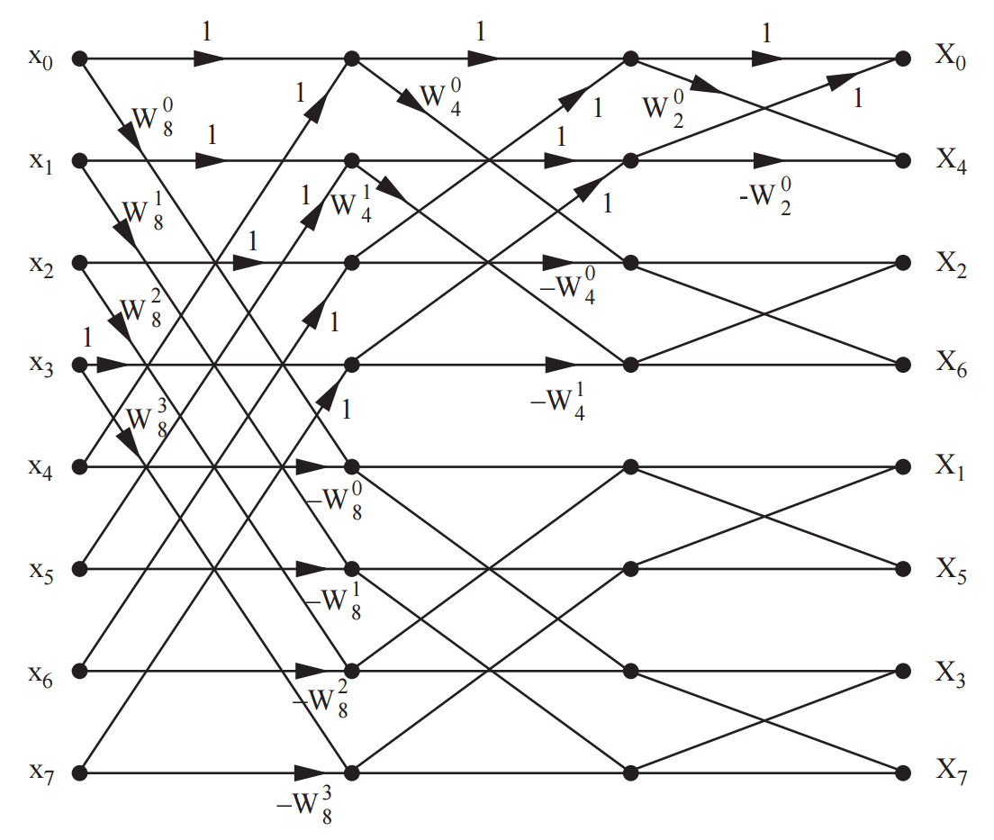
Butterfly Structure Exercise
Decimation in Frequency is reverse of Decimation in Time

Slide 14
Fast Linear Convolution
In order to obtain system response, we can multiply DFTs and take inverse DFT
Be careful, this is not the same as convolution in time, but rather cyclic convolution in time
Therefore, in order to perform linear convolution from DFTs, we must first zero pad signals in order to make wrap-around terms go to zero
If x_{n} has length N and h_{n} has length M, then the resulting convolution is of length N+M – 1
We must pad x_{n} with M – 1 zeros
h_{n} with N – 1 zeros
This will allow multiplication of FFTs to produce linear convolution result from cyclic convolution
Note: we also typically do extra padding so that the signals are of power of 2 length to optimize the FFT

Slide 15
References
Chapters 13 and 14 in Singer’s Textbook
Overlap Add and Overlap Save Stuff @ Chapter 14 Page 16+

